Slide 1
Effective Revision
Academic Skills Centre Exam Essentials

Slide 2
How do you revise?
What techniques have you been using to study and revise so far?

Slide 3
Active learning v passive learning
ACTIVE LEARNING
Focused
Specific: goal-or solution-orientated
Doing something with the material
Deep learning
Big picture – seeing connections and relationships between topics
PASSIVE LEARNING
Unfocused
Broad: try to cover/remember everything
Memorising material
Superficial learning/memorising
Compartmentalised – difficult to make connections with other material

Slide 4
Reflecting on your approach
On reflection, do you feel your approach(es) so far have been:
Mostly active?
Mostly passive?
A mixture of active and passive?

Slide 5
Ineffective (and passive) Learning Techniques
Copying out/rewriting notes
Memorising PowerPoints
Re-reading notes
Highlighting notes or texts
In the past we’ve found that students often use these techniques…
It’s understandable – it’s often how we learn to learn
Time-consuming
Unsustainable – too much material
Passive - Memorising PowerPoints/lectures is not the goal

Slide 6
Effective (and active) Learning Techniques
Key concept – recall (aka information retrieval)
Mixing (active) techniques also key
Active approaches can include:
The ‘blank page’ approach
Flashcards
Sample Questions/Question Banks
‘Teach it’
Group study/discussion
Not an exhaustive list. For more, see:
Revision Bites
https://learningspaces.dundee.ac.uk/ctil/recipes/revision-bites-introduction/
The Learning Scientists
https://www.learningscientists.org/

Slide 7
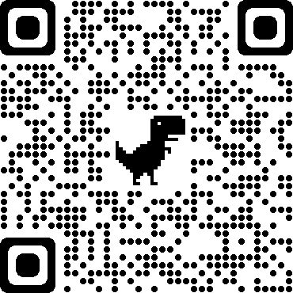
Next steps and further information
More Workshops
Mon 5th Dec, 12-1pm
Thriving in the online exam environment
Wed 7th Dec, 12-1pm
Thriving in the on-campus exam environment

Slide 8
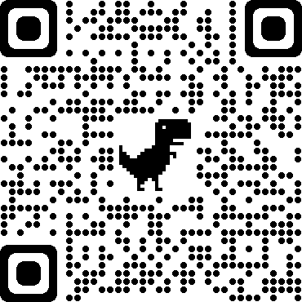
Add your thoughts and questions to this week’s Padlet

Slide 9
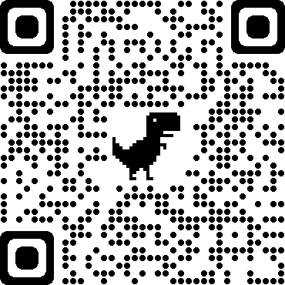
Further Support from ASC asc@dundee.ac.uk
Online Resources
Revision Bites: https://learningspaces.dundee.ac.uk/ctil/recipes/revision-bites-introduction/ ​
The Learning Scientists: https://www.learningscientists.org/
One-to one support
Appointments:
Writing – Royal Literary Fund (RLF) writing tutors
Academic Skills – ASC tutor
Full details and booking process on website
Quick query drop-ins:
No booking required
Details on website

Slide 10
Any questions

